Slide 1

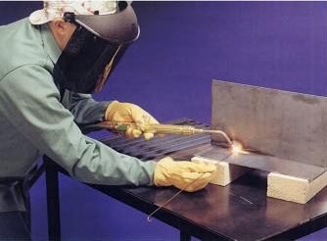
COLD WELDING
PRESSURE GAS WELDING
ROLL BONDING
IC141
Even Semester February-June 2014
Lecture #13
Dr. Mohammad Talha
Asst. Professor
School of Engineering
Indian Institute of Technology Mandi
H.P., INDIA, 175 001
talha@iitmandi.ac.in

Slide 2
COLD WELDING

Slide 3
Definition of Cold Welding
Cold welding:
solid-state process in which pressure is used at room temperature to produce coalescence of metals with substantial deformation at the weld.
Both butt and lap joints can be cold welded.
Die
Flash

Slide 4
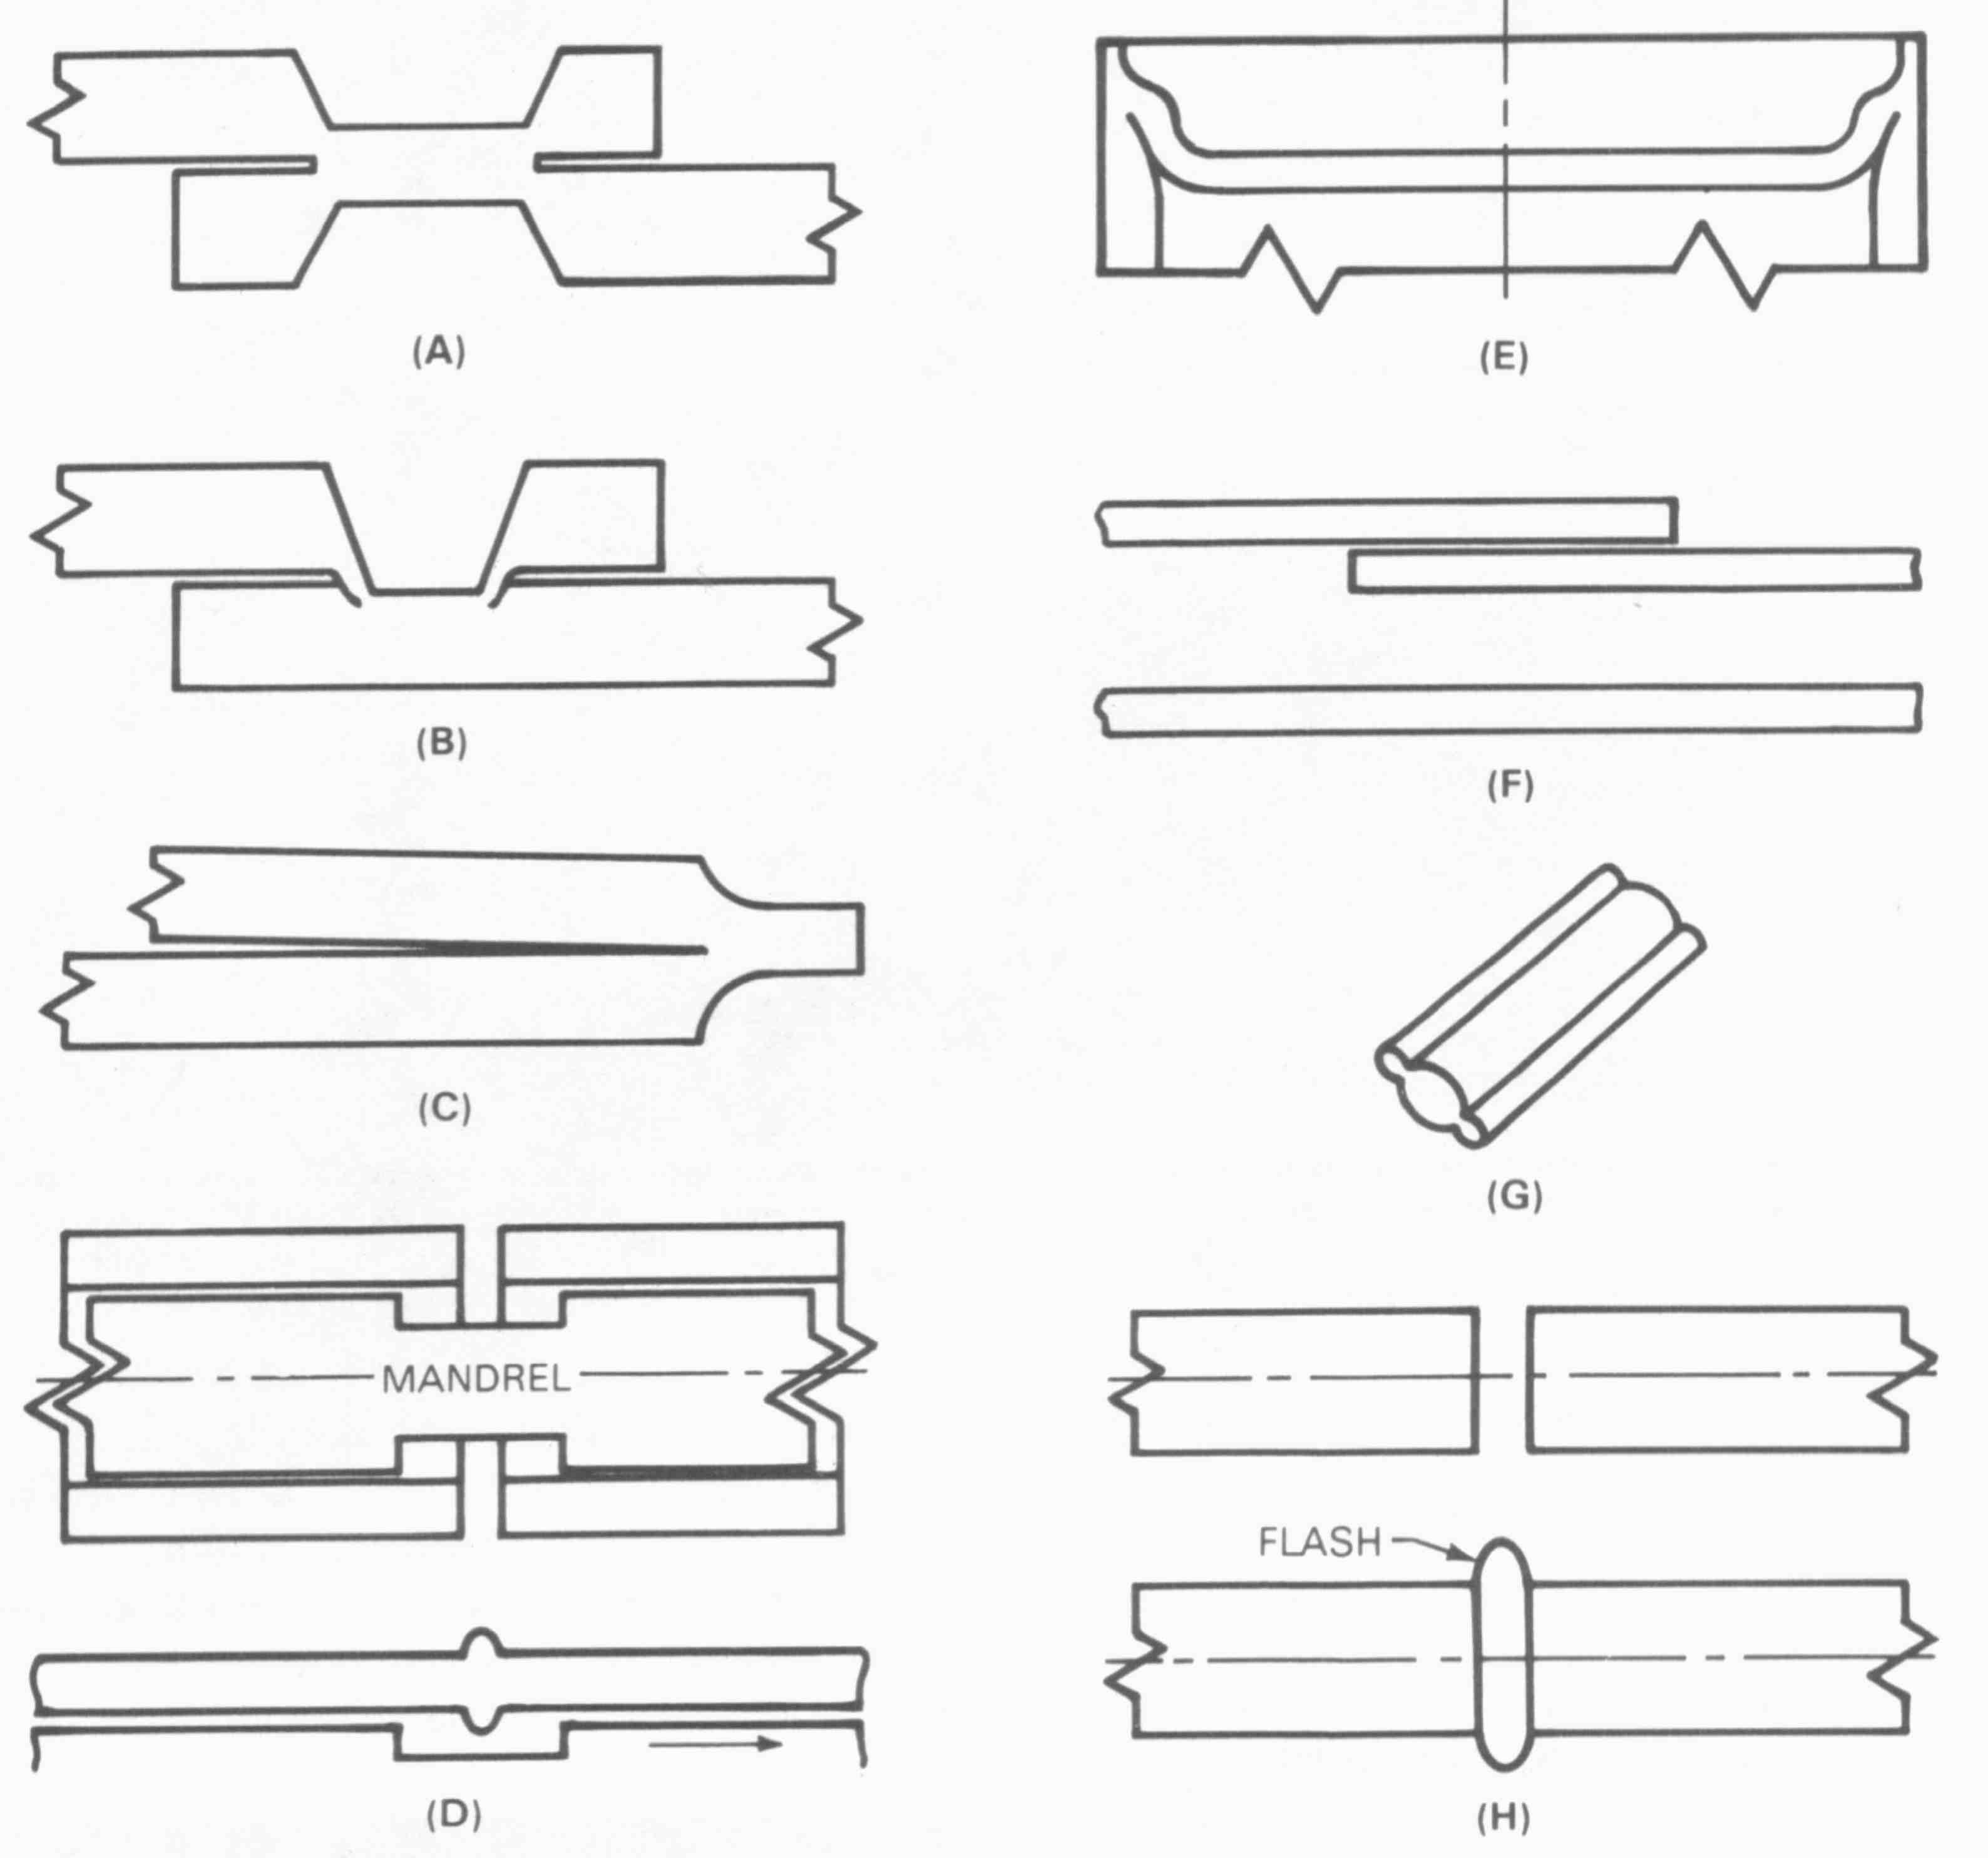
A: Lap both sides indented E: Draw Weld
B: Lap One side indented F: Wire Lap (before and after)
C: Edge both side indented G: Mash Cap Joint
D: Butt in Tube H: Butt (before and after)
AWS Welding Handbook

Slide 5
Characteristics of Cold Welding
At least one of the metals must be ductile without excessive work-hardening.
Total absence of applied heating.
Dissimilar metals can be joined.
Surface preparation is important.
Notes:
Cold welding requires one of the joining metals be ductile and not subject to rapid work hardening. No external heating is required. Surface preparation is usually performed prior to welding. Dissimilar metals can be joined.

Slide 6
Cold Welding Process Description
The parts to be welded are first cleaned.
A short section of the part is sheared.
The parts are clamped in a die with some initial extension.
A forging force is applied to complete welding.
Dies
Workpiece
Workpiece
Before welding
After welding

Slide 7
Applications of Cold Welding
Cold welded butt joints are used in the manufacturing of aluminum, copper, gold, silver, and platinum wire.
Most commonly, successive reels of wire are joined for continuous drawing to a smaller diameter.
Aluminum alloys used in cold welding include: 1100, 2319, 3003, all 5000 series, 6061 and 6201.

Slide 8
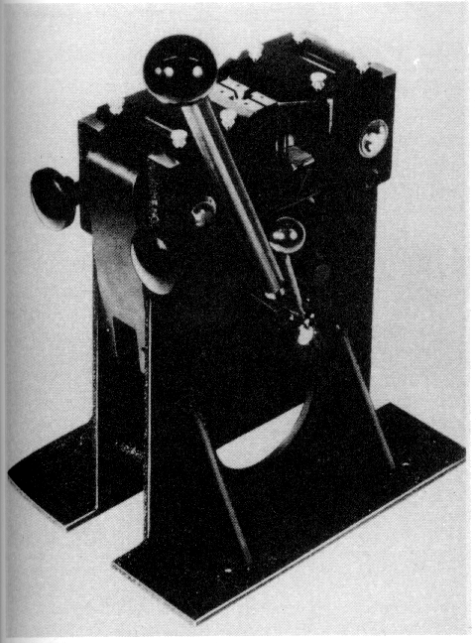
Cold Welding Equipment
A manually operated cold welding machine
(courtesy AWS handbook).

Slide 9
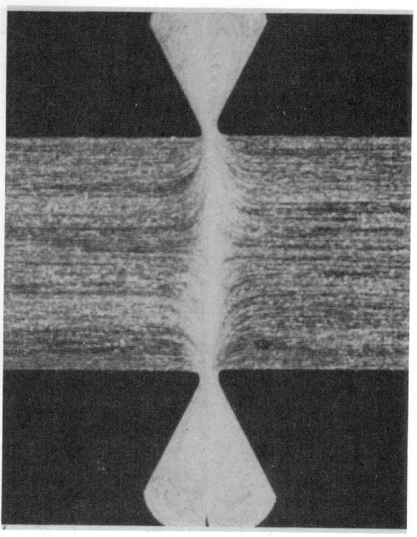
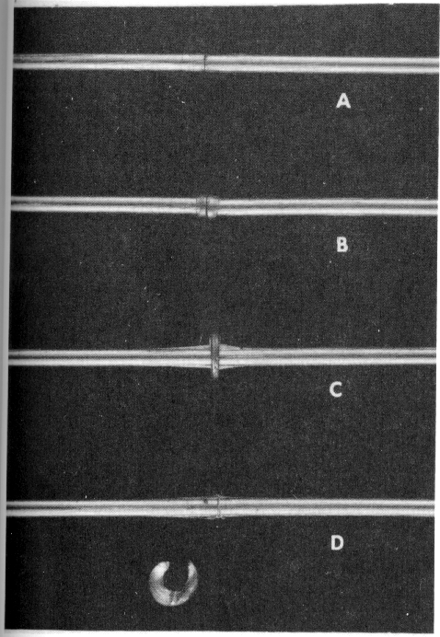
Single Upset Cold Weld in
Type 1100 Aluminum Wire
States of Upset During Butt
Cold Welding
Courtesy AWS handbook

Slide 10
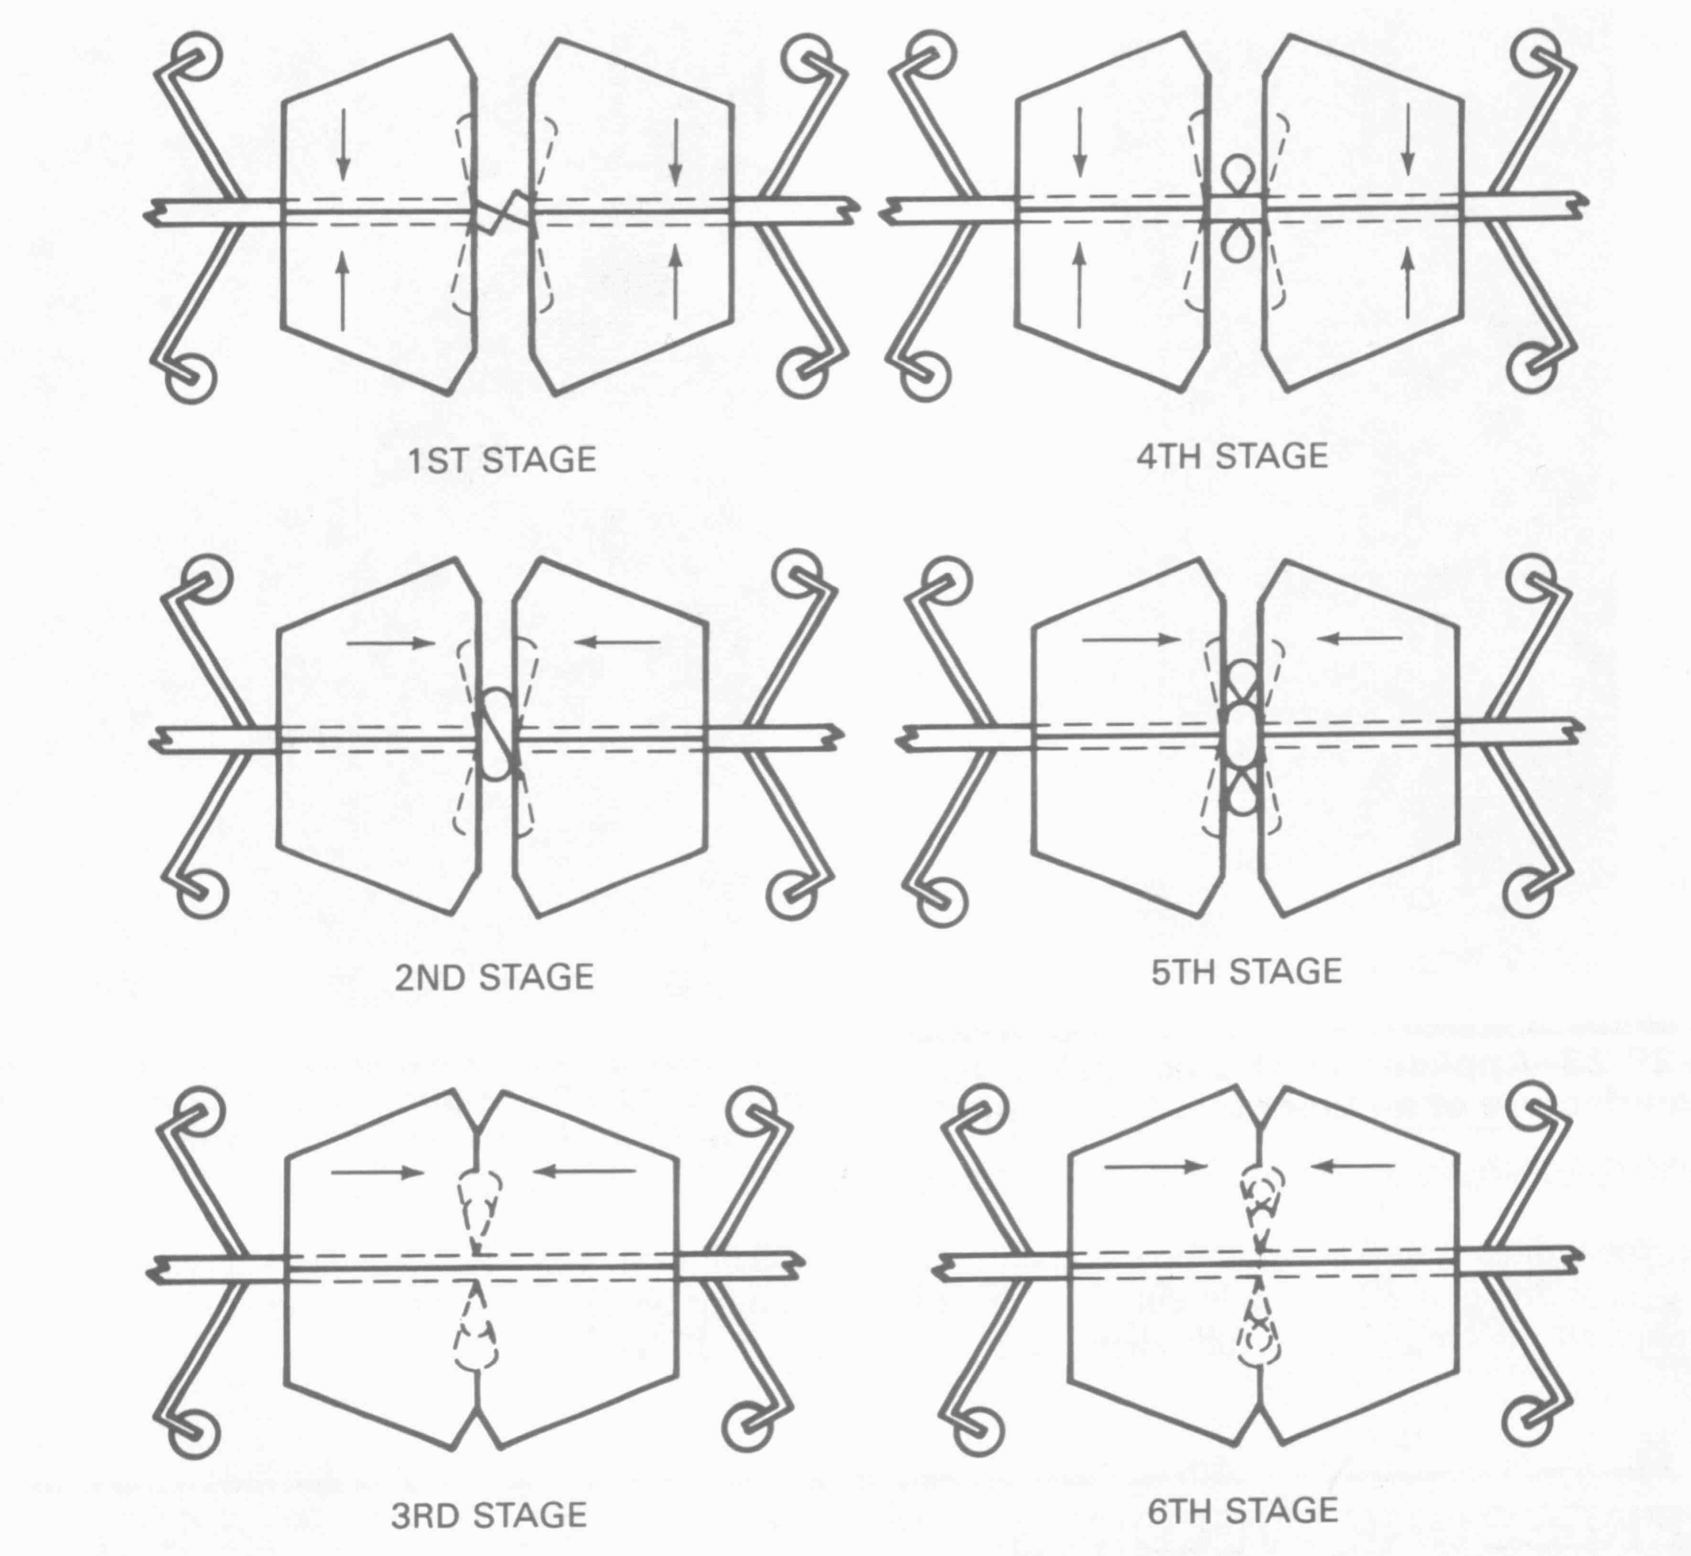
Stages in Multiple Upset Cold Welding
AWS Welding Handbook

Slide 11
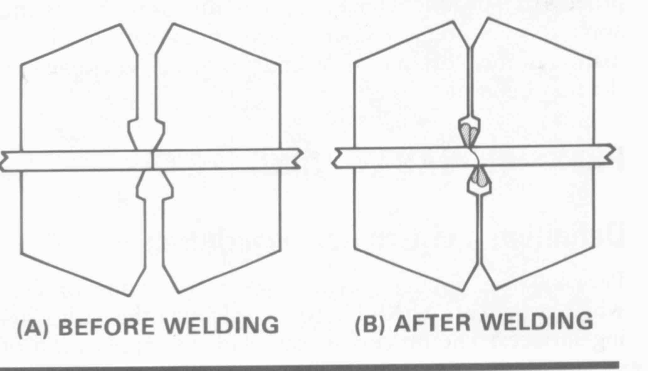
AWS Welding Handbook

Slide 12
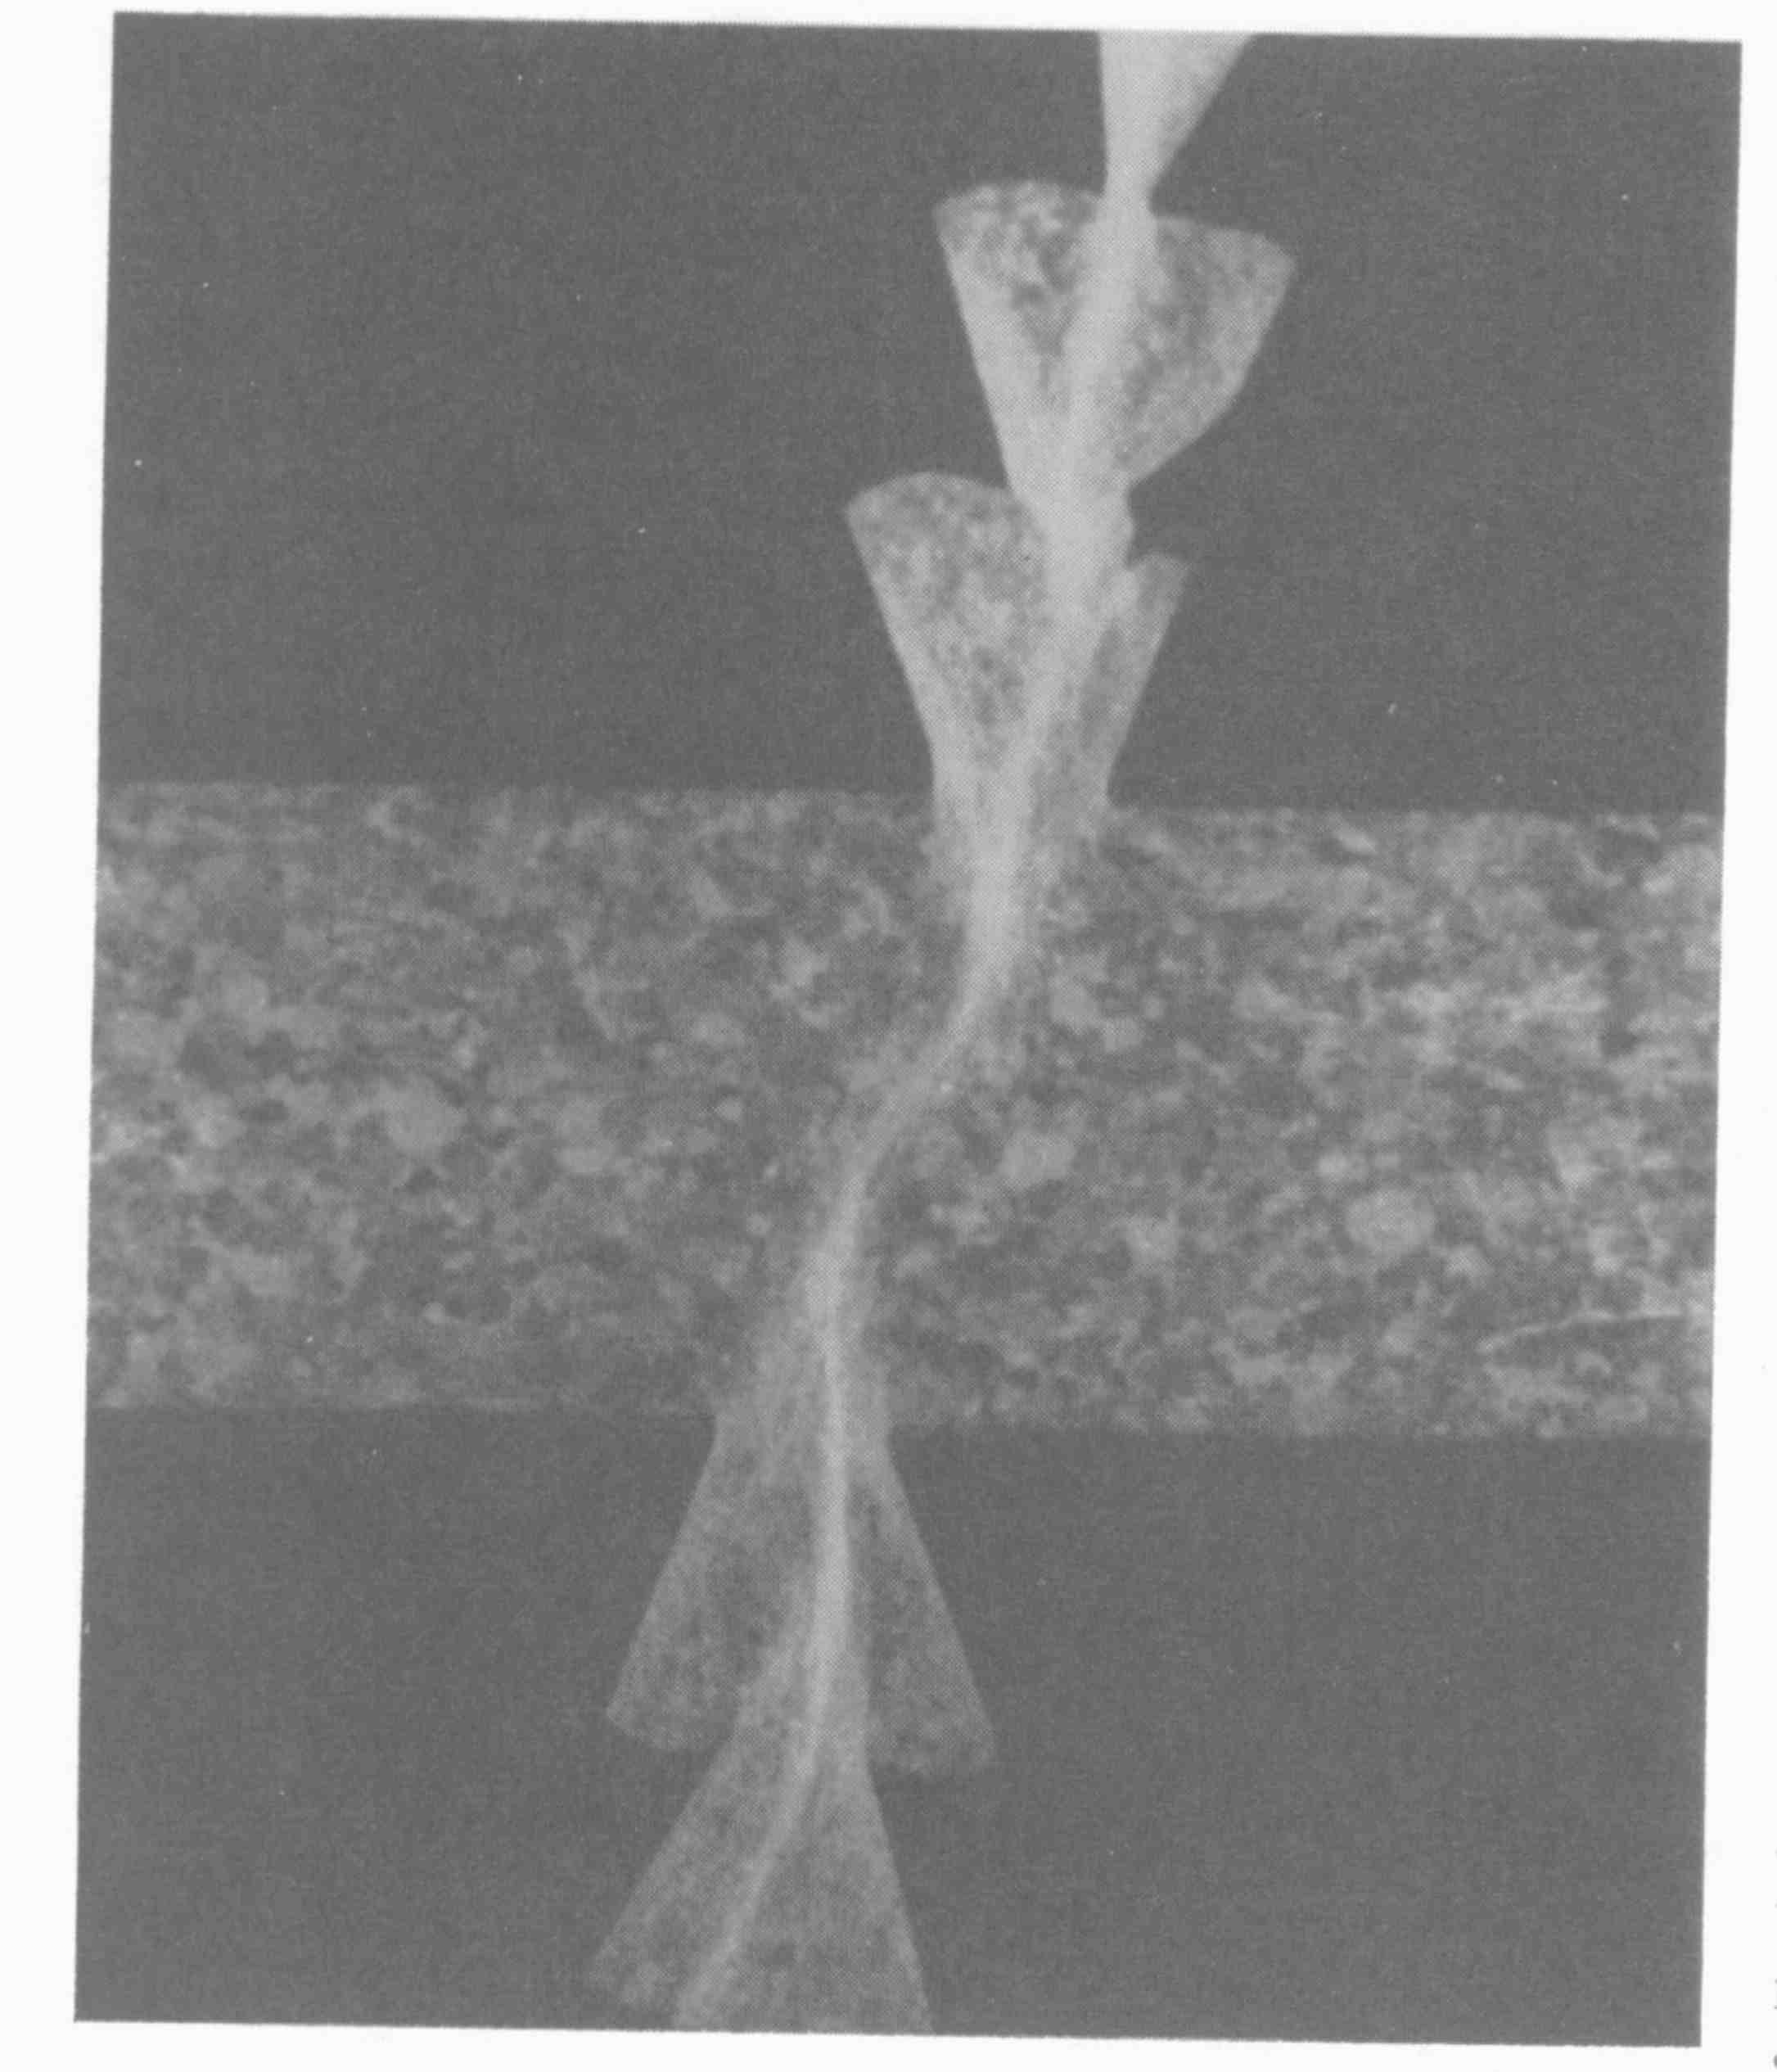
Multiple Upset Cold Weld
AWS Welding Handbook

Slide 13
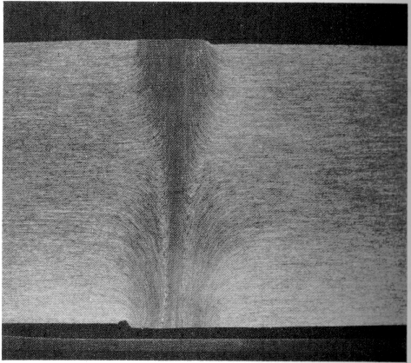
Can Effect Joint Efficiency
Transverse Flow Lines in a
Cold Welded Butt Joint
Courtesy AWS handbook

Slide 14
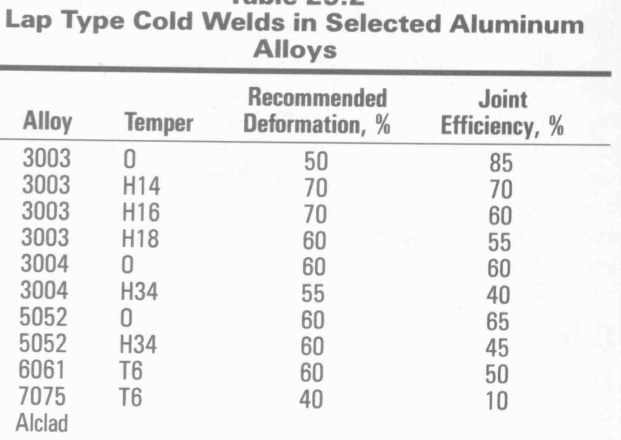
AWS Welding Handbook

Slide 15
Other Cold Welding Applications

Slide 16
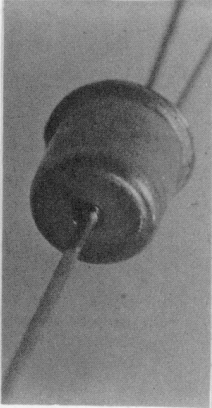
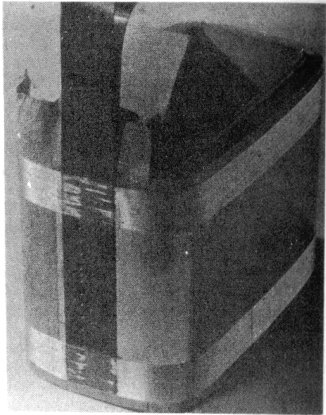
Application
Cold Welding in the Manufacture
of Industrial Packaging
Cold Welded Electrical Component
Courtesy AWS handbook

Slide 17
PRESSURE GAS WELDING
Heat Can Help

Slide 19
Pressure Gas Welding
Definition:
An oxy-fuel gas welding process that
produces coalescence simultaneously over the entire area of the
faying surfaces by heating with gas flames
and by the application of pressure
and deformation, without the use of filler metal.

Slide 20
Pressure Gas Welding Processes
Open joint pressure welding.
Closed joint pressure welding.

Slide 21
Pressure Gas Welding Principles of Operation: Open Joint Method
Principle of Operation
The faces to be joined are heated individually to the welding temperature.
After heating, the two faces are brought into contact.
Upsetting force is applied to complete welding.
Workpiece
Workpiece
Workpieces are heated separately
Upsetting pressure is applied
Upsetting
force
Final weld

Slide 22
Pressure Gas Welding Principles of Operation: Closed Joint Method
Principles of Operation
Flame
Faces to be welded are butted together under initial pressure.
Metal at the joint is heated to welding temperature with a gas flame.
Finally, the metal is upset sufficiently to produce a weld.
Heating torch
Workpiece
Workpiece
Upsetting
force
Upsetting
force
Before welding
After welding

Slide 23
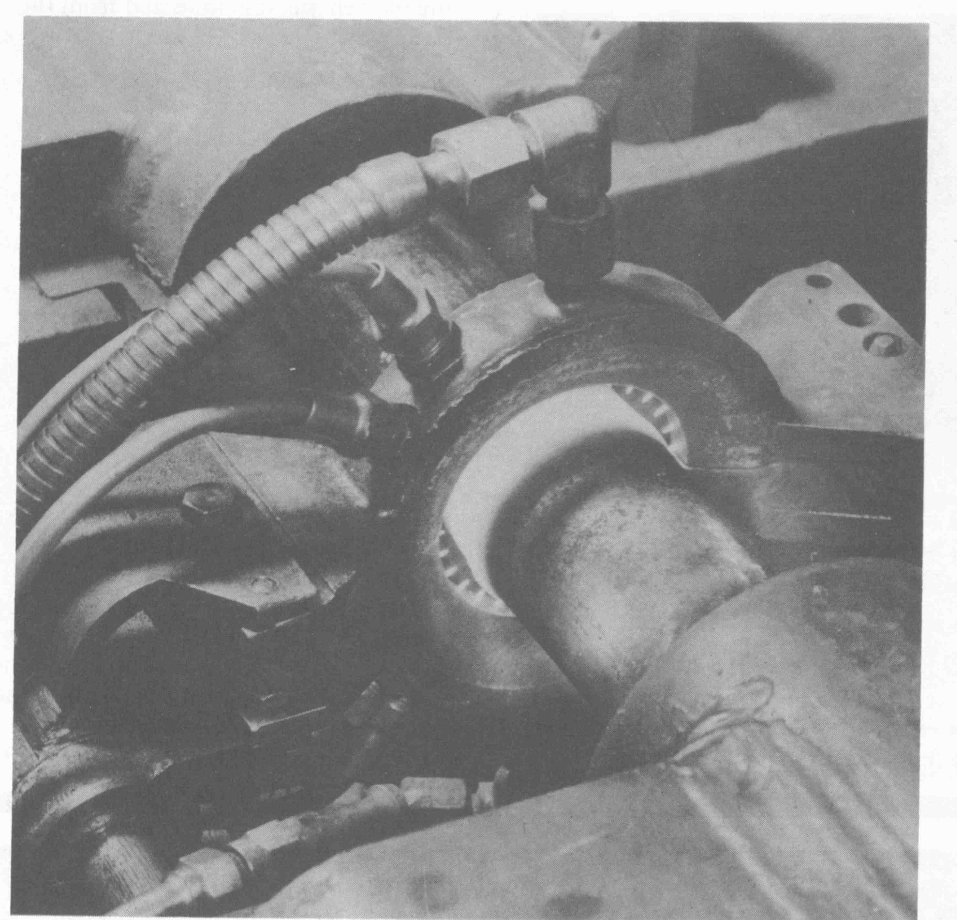
AWS Welding Handbook

Slide 24
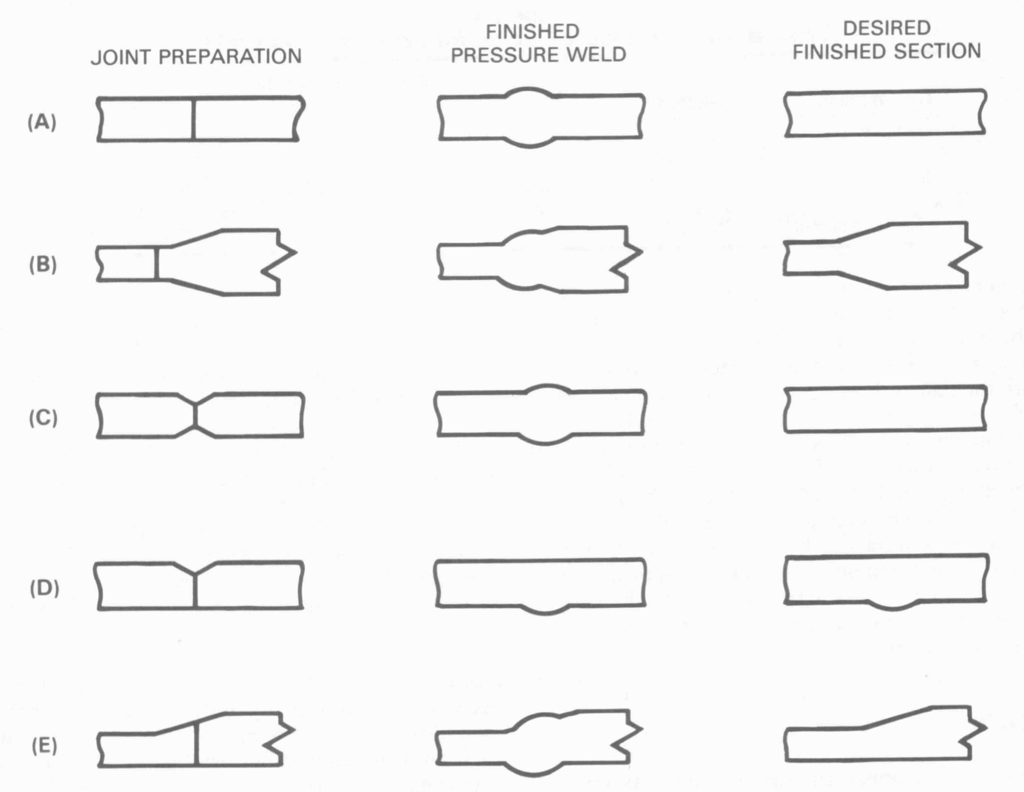
AWS Welding Handbook

Slide 25
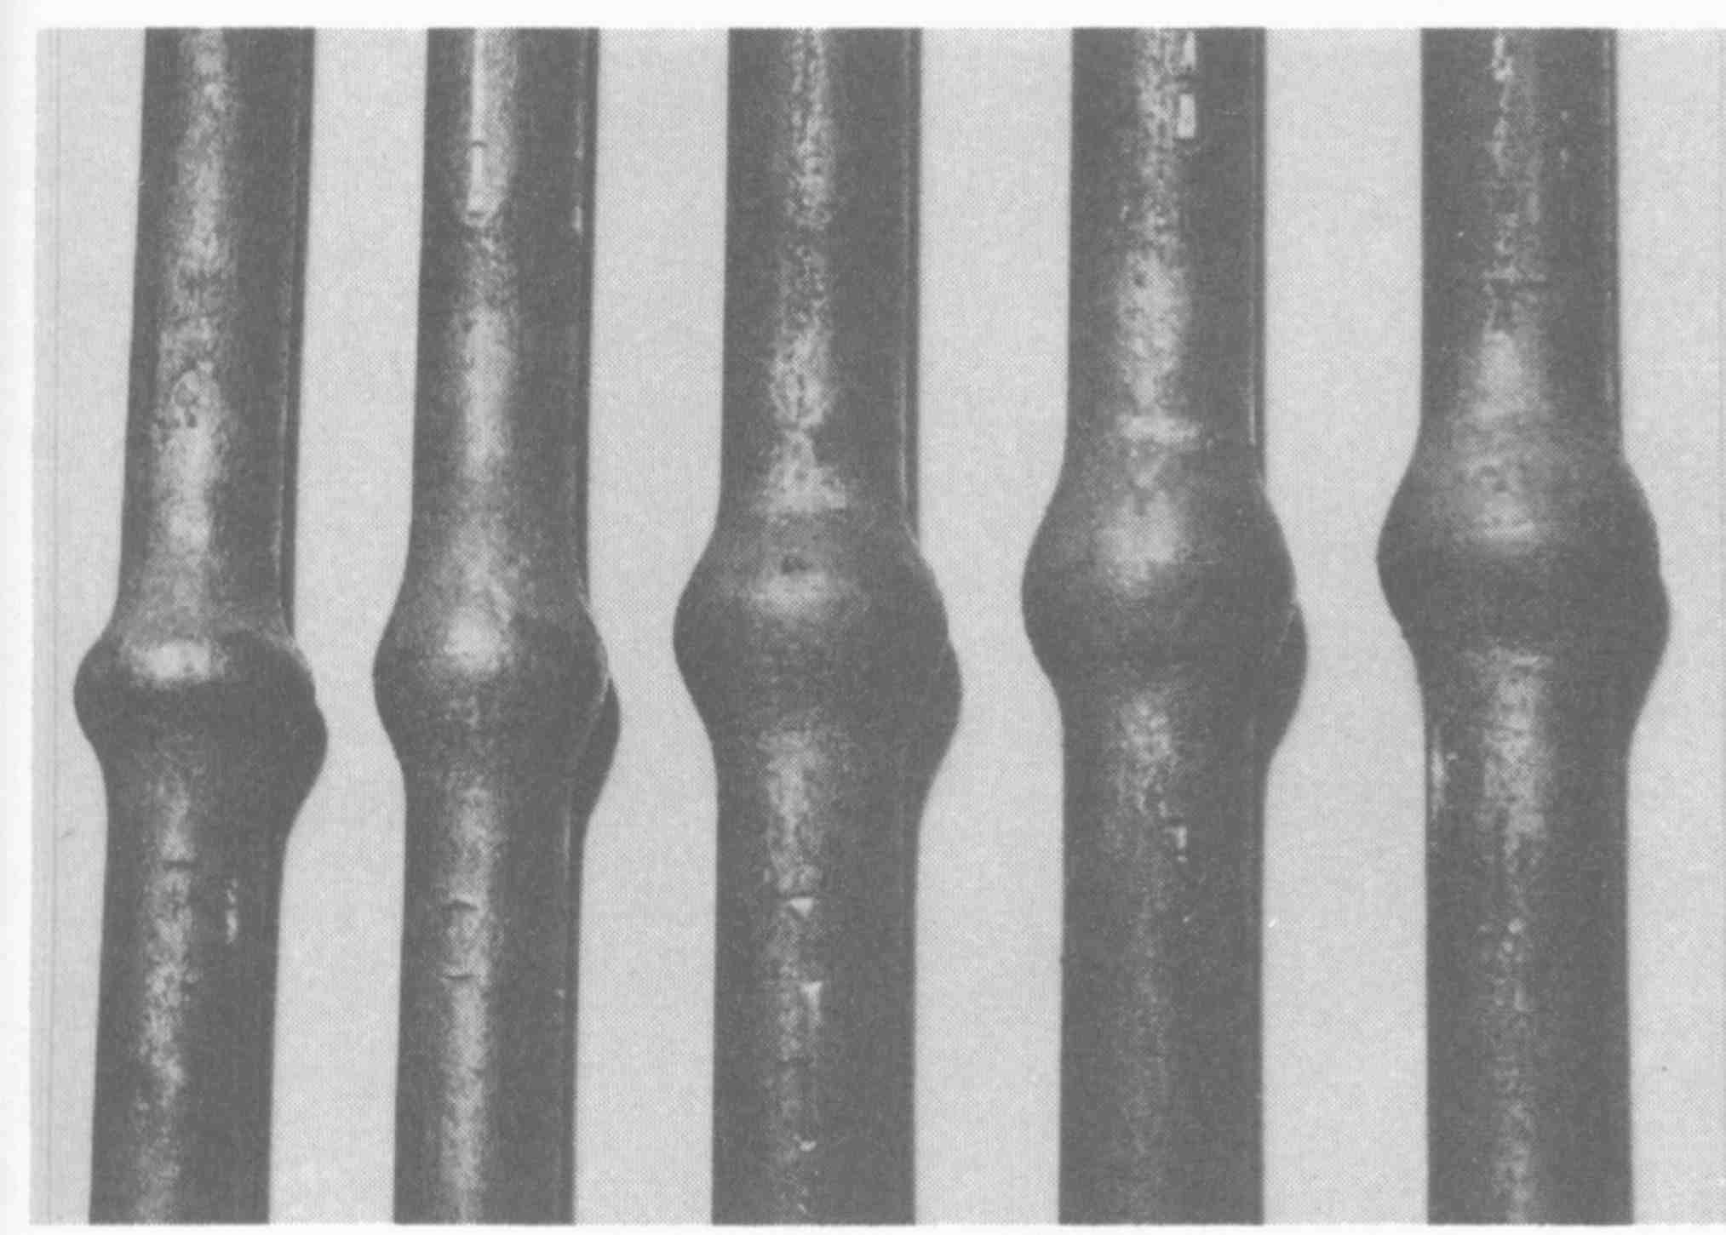
AWS Welding Handbook

Slide 26
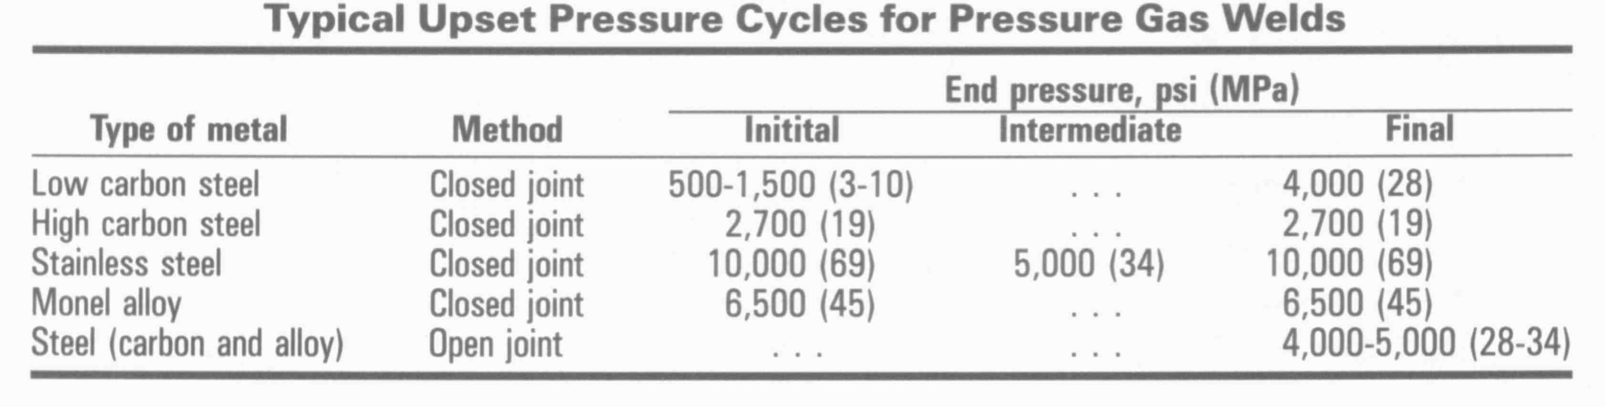
AWS Welding Handbook

Slide 27
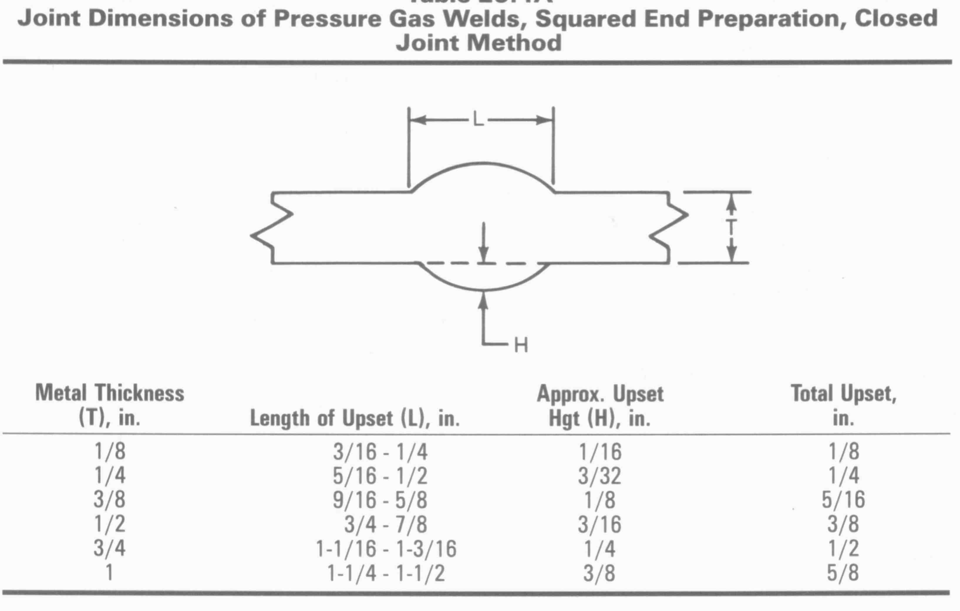
AWS Welding Handbook

Slide 28
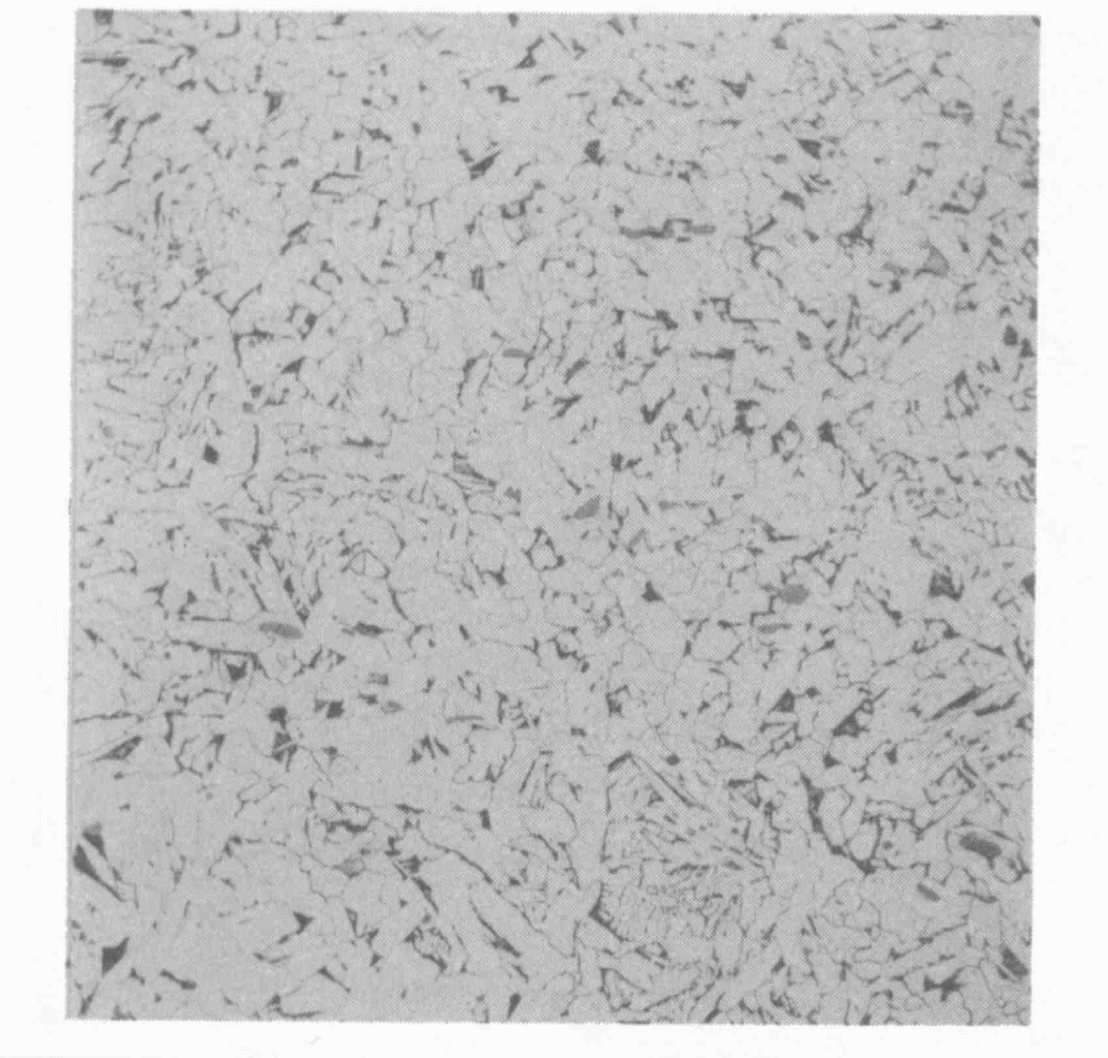
Pressure Gas Weld
Little Visible Centerline
Good Mechanical Properties
AWS Welding Handbook

Slide 29
Applications of Pressure Gas Welding
Applications
Pressure gas welding has been successfully applied to
plain carbon, low carbon, and high alloy steels, and to several non-ferrous metals, including nickel-copper and copper-silicon alloys.

Slide 30
Forge Welding
The Blacksmith’s Art

Slide 32
Forge Welding
Forge welding is a solid-state welding process
That produces a weld by heating the work pieces to welding temperature and applying blows sufficient to cause permanent deformation at the faying surface.
Forge welding was the earliest welding process and the only one in common use until the 19th century.

Slide 33
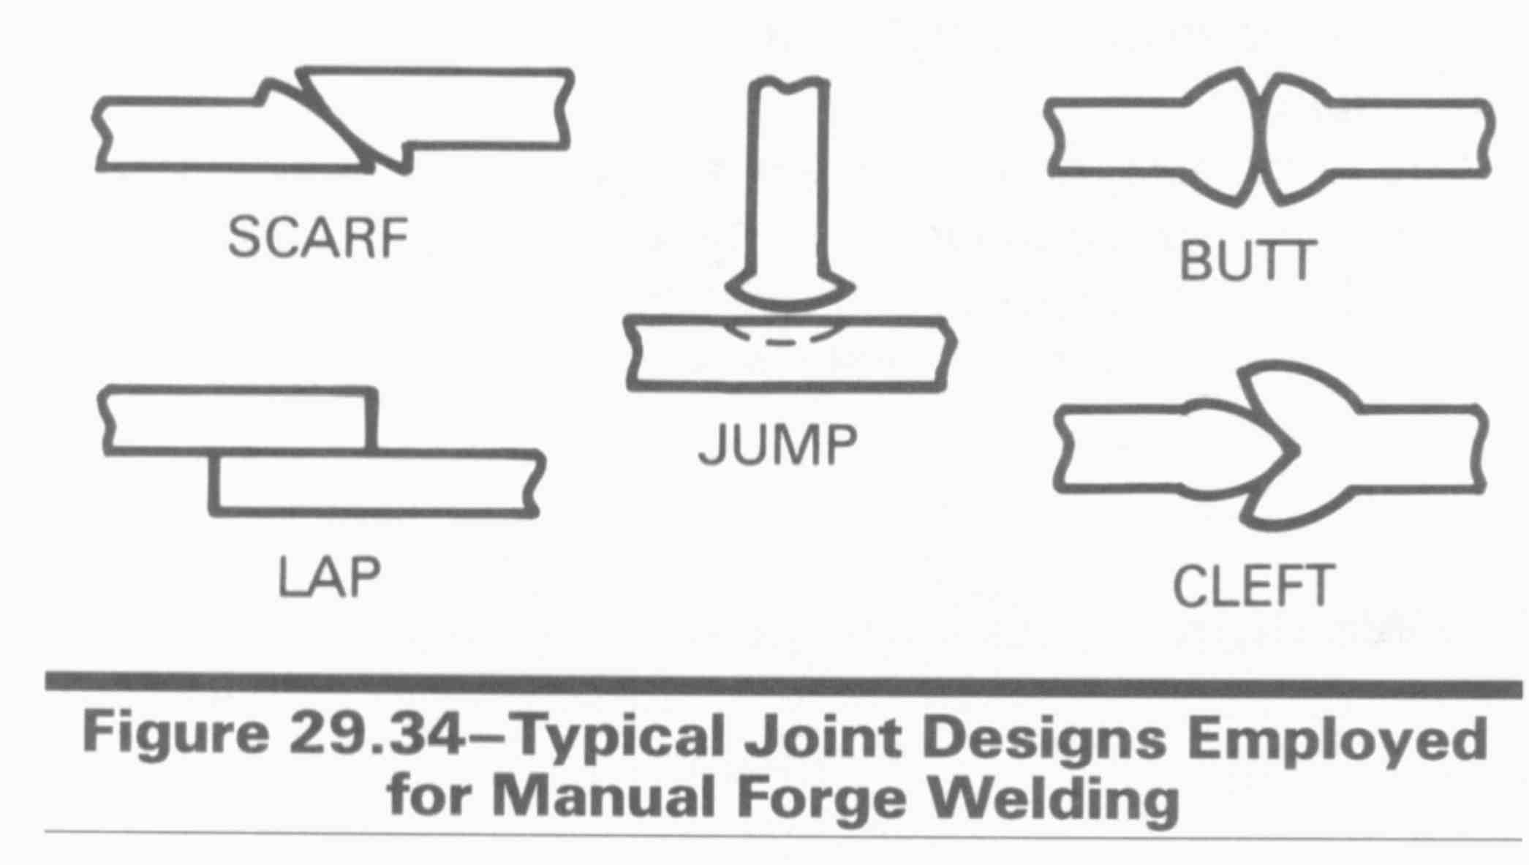
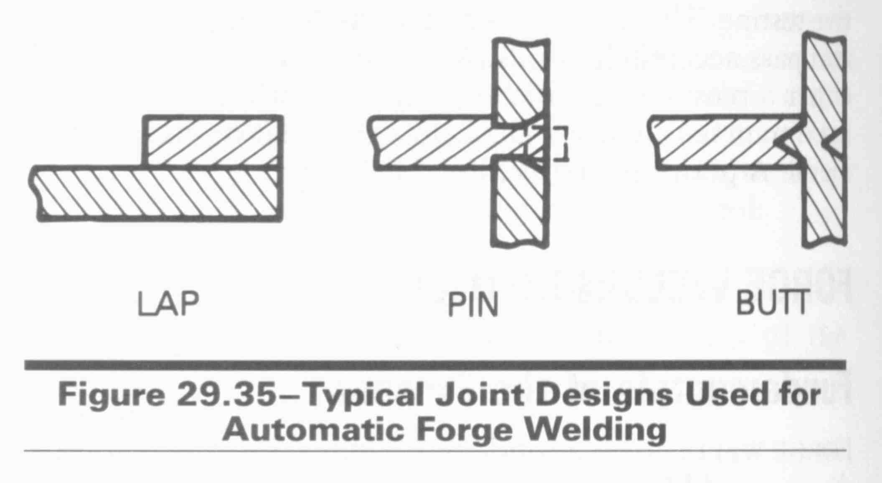
AWS Welding Handbook

Slide 34
Fluxes
Often fluxes are needed to prevent oxide formation on the parts to be welded. Two commonly used fluxes for steels are silica sand and borax (sodium tetraborate).

Slide 35
ROLL BONDING

Slide 36
Nascent Surface
Defined as the new surface formed during compressive plastic deformation (upset).
Can be free of oxides and contamination.
Increased nascent surface area usually results in increased weld strength.
Interface
Nascent
Surface
Original
Deformed
Area increase under compressive
plastic deformation (upset)

Slide 37
Roll Bonding
A solid state welding process
in which bonding is made between two
sheets of metal by passing them
through a rolling mill.
Surface preparation is of utmost importance.
Welding is promoted with increasing temperature, increasing pressure, increasing roll diameter, and decreasing rolling speed.
60 to 70% deformation is required for maximum weld strength.

Slide 38
Weld
interface
Y
b
a
X
Nascent surface
Original weld interface
Plane Strain Roll Bonding
(Deformation in thickness and length only.)
% reduction in thickness
% nascent (new) surface
Rolling

Slide 39
Plane Strain Roll Bonding
Assuming constant volume, xy = ab or a/x = y/b
% reduction in thickness is equal to % nascent surface, assuming no change in width.
For 100% nascent surface 100% reduction in thickness is needed.

Slide 40
Surface Deformation
Bulk compressive deformation or upsetting is measured as the percentage reduction in sheet thickness.
A threshold deformation exists below which no weld is made.
Above this threshold the joint strength is close to that predicted by assuming the welded area is the nascent surface area.
Increasing the temperature reduces the value of threshold deformation.
Predicted strength
Strength of welded joint.
Strength
Threshold
deformation
Deformation%

Slide 41
Steel - Aluminum Cladding
Rolling
a. Cold
b. 600-750 F
Cleaning
Post-Heating ~ 1000F

Slide 42
FeAl₃, Fe₂Al₅
Steel
(Brittle)
Si > 0.25% in Steel
Tends to Reduce
Brittle Iron-Alumindes Thus Higher Post Roll Temperatures can be employed
Aluminum
Steel
Steel
Aluminum
Steel
Steel
Aluminum

Slide 43
Aluminum - Titanium
Aluminum
Titanium

Slide 44
Stainless Steel Clad Aluminum & Copper
Hot Rolled
Aluminum
Stainless Steel
Stainless Steel
Copper

